Slide 1
Data Management and Information Science
Gary Marchionini
University of North Carolina at Chapel Hill
march@ils.unc.edu
Open Source Enterprise
Reston, VA
June 9, 2016

Slide 2
Outline
Data and Information Context
Information Professionals’ Roles
Digital Representation Blur
Data Curation and Data Science
The OSE-SILS Executive Education Program

Slide 3
Data and information context
Part 1

Slide 4
Data and Information Circa 2016
Recognition [panic?] that data analysis, reuse and preservation are increasingly important
Nature (2008); Science (2011); The Fourth Paradigm (2009); McKinsey Global Institute: Big data (2011)
Many applications: Recommender systems (e.g., Amazon); Precision medicine, Trend predictions, etc.
Legal and ethical guidelines (e.g., data mining; Right to be forgotten; data breeches)
OSTP directive for data management plans and public access; February, 2013
Workshops, courses, programs galore

Slide 5
Data Public and Private
‘Big’ Science Projects
Physics, genomics, astronomy, social science, earth science
Collaborative repositories, stable funding
Other science and humanities
The long tail
Individual scholars, small and intermittent funding
Corporations
Competitive advantage (Amazon, Taoboa, Google, Baidu, Facebook, Alibaba)
A primary income stream
Government data
Economic metrics (e.g., Census, other statistical agencies)
Intelligence streams
Data Uses
Verification, documentation, and authority
Aggregation and scaffolding
Mining; inferencing
Reuse

Slide 6
Information professionals’ roles
Part 2

Slide 7
Information Professionals’ Roles
Information professionals integrate people, information, and technology.
Digital assets blur traditional boundaries between physical components: core challenges
Knowledge representation
Data curation and data science
Information interaction
iSchools educate information professionals for all kinds of enterprises: business, industry, government, as well as libraries and archives

Slide 8
Information
Information is intellectual energy
Reduction in uncertainty (Shannon)
Random perturbations-signals-data-information-knowledge continuum
Four senses of information
Action
Thought
Thing
Cyberidentity
Notes:
Random pertubations, ambient noise, signals have order/system, data has simple context (e.g., unit of measure), information has rich context/metadata; knowledge connects contexts and concepts/people/events

Slide 9
Fundamental Information Questions
How does information arise? [genesis]
How does information flow in an organization?
How is information managed in an organization and across organizational membranes?
How is information used?
How is information preserved and secured for future use?
How do we assess these activities?
Notes:
Information is a key asset of the modern world and the study of information concepts and services drives progress in the digital age. All industries and enterprises demand information professionals who manage the data and information streams of modern life. Traditionally, information professionals worked in libraries, record centers, and archives, but in the digital age all enterprises require professionals who are able to monitor and manage how information is generated, organized, used, and preserved. Digital representation blurs traditional boundaries between information streams and brings new challenges for linking human needs to those streams through new technologies. Rooted in the values of library science, today’s information schools (iSchools) educate information professionals who possess a broad range of technical and information skills and who work in all aspects of human endeavor.

Slide 10
Fundamental Information Questions (Cont’)
What do all humans have a right to know?
How do we help humanity collect and use evidence for decision making
What data assets should we collect and maintain?
What data analytic techniques and tools should we collect and help people use?
How do we evaluate information assets?

Slide 11
Information Work
Collect and build collections (appraisal, acquisitions)
Assess human information needs (individual, collective)
Manage items, collections, and workflows
Policy-based rules
Add value (e.g., metadata; alternative views; indices)
Assist people (customers, patrons)—policy-based and customized services
Preserve information assets for reuse
Create new information (synthesis, visualizations)
Notes:
Keep these in mind as we talk about data science

Slide 12
Example: Digital representation blur
Part 3

Slide 13
Representation and the Digital Blur
World
Physical
Mental
Physical Representation
Clear boundaries
Information
Object
Representation
Level 1
Recorded
Ephemeral
Representation
Level 2
metadata
surrogates
Digital Representation
Bits are Bits
World
Physical
Mental
Digital
Representation
(likely a stream)
Information
Object
metadata
surrogates
annotations
Notes:
13

Slide 14
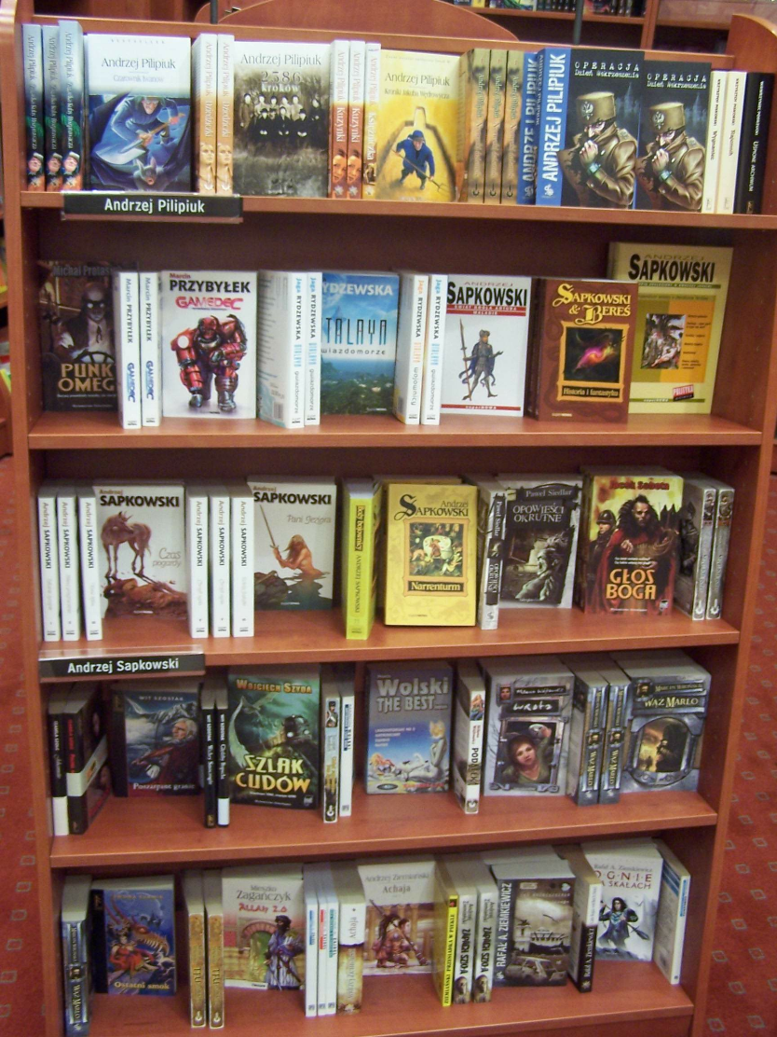
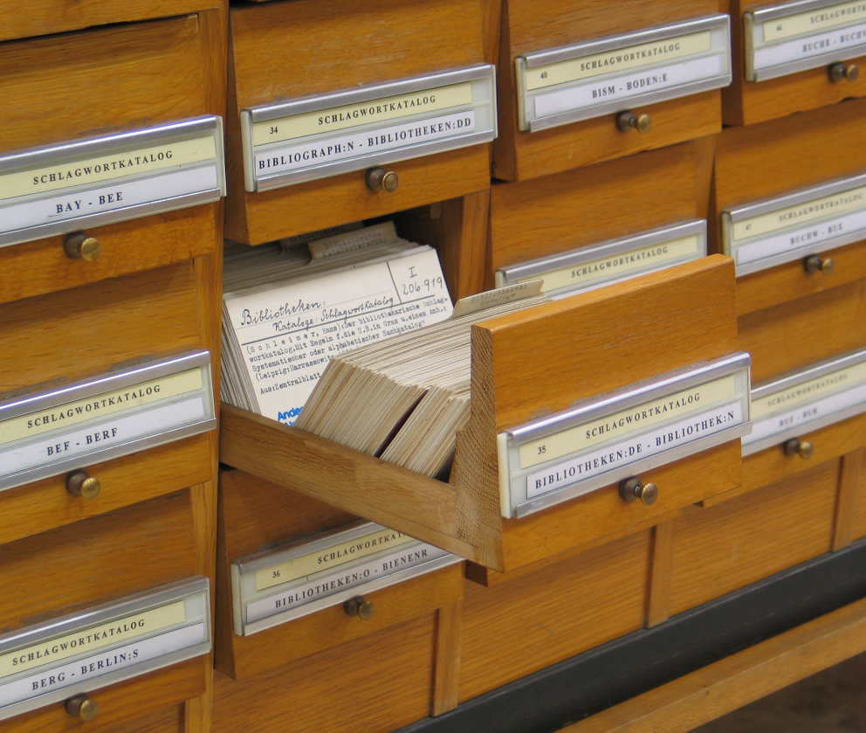
=/=

Slide 15
The Blur
The (relatively) Neat Past and the Very Scruffy Present
Blurring the ‘levels of representation’ model of information (primary-secondary-tertiary-n-ary)
The metadata—surrogate continuum within the levels of representation continua
Metadata region mainly for retrieval
Metadata region mainly for and by machines (e.g., semantic web)
Automatic metadata generation advances
Implicit links and mining of interactions as metadata
Surrogate region mainly for sense making
Surrogate region mainly for and by people
Professional abstracting
Social tagging and annotations/links as surrogates
Notes:
15

Slide 16
Content, Metadata, & Context: Boundaries?
history
usage
links
Content
Package
comments
Video
file
Data analytics
applied here
The World
(Base context)
The World
Time N context
Release
Time
Time N
Notes:
Content package includes metadata, surrogates
16

Slide 17
Example: Multimedia Features for Indexing
Linguistic surrogates
Images
color, texture, luminosity, shape
Video
same as stills but add motion (e.g., optical flow)
Sound
speaker attributes, pitch, duration
Usage patterns

Slide 18
Example: Digital Video Surrogates
Classes
Textual
Visual
Audio
Multimedia
Cost benefit analysis: maximize ‘meaning’ per unit time
Transmission time
Compaction rate
Cognitive processing time
Performance vs. Preference
Curation considers these human-centered concerns as well as technical concerns
Notes:
18

Slide 19
Example Instantiation: Color Histogram
Each pixel has color ‘depth’ (e.g., 128 bits)
Divide image into regions (e.g., 8x8 pixels)
Create a histogram for each region (amount of red, cyan, etc.)
The set of histograms serves as a quantitative representation for the image, allowing comparisons and rankings
Caveat: Querying awkward (use QBE)

Slide 20
User Persepctive: Surrogates (Views)
Text
Superimpositions (supers)
bibliographic
Visual
Storyboard
Slide show
Fast forward
Audio
Speech
Music, sounds

Slide 21
Example Video Surrogates
Storyboard
(Static)
Slide Show Interface
(Dynamic)
1
2
3
4
Image 3, etc.
1
5
6
7
8
9
10
11
12
Frame being shown: 1
Image 2
Notes:
over past several years, Digital Library Research Group at University of Maryland have used some video browsing surrogates in user studies:
static: storyboard
dynamic: slide show and simultaneous slide show
postulated advantages of dynamic surrogate:
maintains “native” temporal dimension of video
physiological: reduces need for eye movements
physiological: ~100 ms = processing time in “working memory”
psychological: leverages “selective attention” capabilities; motion attracts attention
conducted empirical studies -- determined thresholds
e.g., max kfps for providing meaning for various user tasks?

Slide 22
Interfaces
Different views: overview, preview, review, peripheral view, shared view
Different mechanisms for using the views

Slide 23
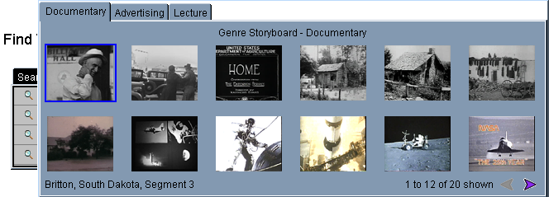
Storyboard Example by Genre

Slide 24
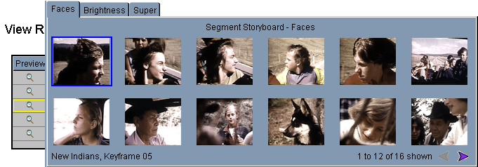
Array of keyframes, indexed by Faces

Slide 25
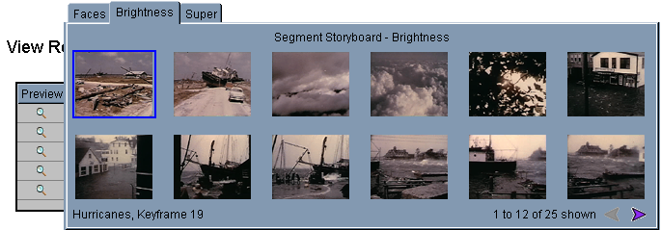
Array of keyframes, indexed by Brightness

Slide 26
Indexing in Context of Curation
Acquire
Ingest
Index
Preserve
Access
Understand/interpret

Slide 27
Data Management Policies
Scores of decisions are made about acquisition, indexing, access, retention, and use. These decisions should be instantiated in policies
Example for Indexing
What features to index? [classification]
How to assign values? [cataloging, tagging]
Procedure for tagging? (e.g., manual, automatic, crowd sourced)
How to store or link data and tag?
How to store or link workflow?
Policies are constrained by costs, benefits, risks

Slide 28
Data curation and data Science
Part 4

Slide 29
Data as Popular Concept
Signal-data-information-knowledge taxonomy
Classic information science
Data volume, variety, velocity, and veracity
Digital environment drives each of the v’s
GOOD data rather than big data
Good critical to good inferences and decisions
Information scientists are concerned with the entire data life cycle
Data curation depends on defining and operationalizing policies

Slide 30
Why is research data stewardship complex?

Slide 31
Organization
Metadata
Ethics
Representation
Preservation
Information
Science
Knowledge
Domain
Summarization
Inference
Modeling
Evaluation
Context
Content
Culture
Application
Data
Science
Statistics
Computer
Science
Algorithms
Efficiency
Machine architectures
Automated processes

Slide 32
Information & Data Science
Information scientists are concerned with the entire data life cycle and also with the socio-cultural issues associated with data collection and use. Some examples include:
Ethical and legal conditions associated with data collection (e.g. informed consent, privacy, and legal regulations);
Appraisal, data quality, and cleaning;
Metadata assignment that documents context (e.g. units of measure, conditions of sensors, and vocabulary controls) both for machine efficiency and human interpretation;
Storage and preservation of data (e.g. replication and authentication policies) and associated traces of processing and use (e.g. documentation of data cleaning, analysis algorithms applied, and overall workflows);
Evaluation of conclusions based on data exploration and analysis and making the data and workflows findable and reusable.
Metadata assignment in documents context both for machine efficiency and human interpretation.

Slide 33
SILS Data Curation Perspective
Application/domain area(s)
Defining research questions, data collection
Data/metadata quality and validity
Description/metadata, provenance, intellectual control, handling heterogeneous data types, data management
Storage and access
Storage mechanisms, access to data sets, security, preservation
Analysis and visualization
Statistical analysis, data/text mining, machine learning algorithms, algorithmic pre-processing of data, visualization of results
Evaluation and interpretation
Evaluating the validity of the results, interpreting the results, understanding the implications of the results
Legal and social issues
At beginning and end of process; privacy, intellectual property, security, socially impactful uses of results (negative or positive)

Slide 34
Challenge: Managing Blurred Boundaries
Applications, Interfaces, Security
Open WWW
Private Web
Curated Web

Slide 35
OSE and SILS Executive Education Program
Part 5

Slide 36
What’s Next?
Introduction to Data Management Concepts and Practices
Gary Marchionini & Helen Tibbo
Wednesday-Thursday, 7-8 September 2016
Demystifying the Web
Rob Capra
Friday, 9 September 2016 (morning)
Data and Databases
Stephanie W. Haas
Friday, 9 September 2016 (afternoon)
Trusted Repositories
Helen Tibbo and Cal Lee
Monday, 12 September 2016
Data Sharing Constraints and Issues
Cal Lee
Tuesday, 12 September 2016

Slide 37
Next?
Using Forensics Tools and Methods for Data Curation
Cal Lee and Kam Woods
Wednesday, 14 September 2016
Big Data Analytics & Cloud Computing
Arcot Rajasekar
Thursday, 15 September 2016
Data Policies
Arcot Rajasekar
Friday, 16 September 2016
Metadata Concepts, Creation, and Use
Melanie Feinberg
Monday, 19 September 2016
Information Retrieval and Text Mining
Jaime Arguello
Tuesday, 20 September 2016

Slide 38
Post-Master’s Certificate In Data Curation
UNC Degree (30 credit hours)
Summer on-campus introduction (2 weeks); then online courses (1.5 years typically)
Two semester project pertinent to work or student cohort interest
Application Requirements: Master’s degree; application (statement of interest, transcripts, no GRE required)
Agency provides tuition support

Slide 39
PMC Courses
INLS 465: Understanding Information Technology for Managing Digital Collections (summer on campus 2 weeks)
INLS 490: Selected Topics: Information Analytics
INLS 523: Database Systems I
INLS 624: Policy-Based Data Management
INLS 696: Independent Study Part I (part one of student-defined capstone project; ideally team-based)
INLS 696: Independent Study Part II (part two of student-defined capstone project; ideally team-based)
INLS 720: Metadata Architectures and Applications
INLS 740: Digital Libraries: Principles and Applications
INLS 752: Digital Preservation and Access (summer on campus 2 weeks)
INLS 756: Data Curation and Management

